Slide 1





Flavor Forge
Cook What you Lovea!
Your Gateway to Delicious, Personalized Recipes!

Slide 2

Contents
Member List
Introduction
Why Flavor Forge?
System Overview
System Workflow
Conclusion

Slide 3

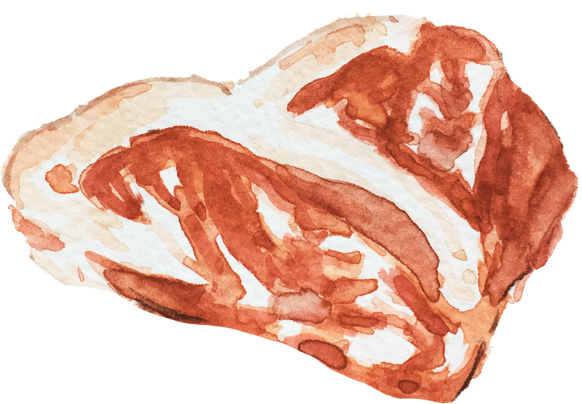

Member List
Nyan Min Htet YKPT – 22319
Soe Sett Lynn YKPT – 22322
Thura Aung YKPT – 22352
Zin Min Htun YKPT - 21716
Kaung Myat Htun YKPT – 21883
Nain Aung Linn YKPT - 22316
Thet Su Lwin YKPT - 22390
Hla Myat Thwe YKPT - 22399
Yoon Thiri Aung YKPT – 22425
Hsu Lae Nwe Ni YKPT - 22439
Chaw Hsu Thin YKPT - 22454

Slide 4

Introduction
Flavor Forge is a recipe exploration system that helps you
- Search
Filter, and
Discover recipes based on ingredients, cuisine, course, diet preferences, and allergens, making cooking personalized and easy.

Slide 5



Why Flavor Forge?
User Struggle to find recipes tailored to their dietary needs and preferences.
Existing platforms often lack custom filters and interactive search features.
Goal : Provide a fast, personalized recipe discovery system using distributed architecture.

Slide 6
System Overview
Client-Server Architecture
--------------------
UI Client
----------------
Java RMI for
remote method invocation
JavaFX UI Client
for an interactive user experience.
API Integration
-----------------
Fetches Real-time data from
Spoonacular API

Slide 7
System Workflow
User Preference Selection
Recipe Search
Ingredient Display
Allow users to choose ingredients. they already have or prefer to use.
Enable selection of specific cuisines.
Provide options for recipe types.
Support dietary preferences.
Let users decide the number of recipe results they want to see.
Implement a search feature that generates recipe results based on user preference.
Ensure recommendations are accurate, diverse and easy to follow.
Show a clear list of ingredients required for each recipe.
Highlight related or alternative ingredients for flexibility in cooking.

Slide 8




Meal Planning Support
Assist users in planning meals by giving them access to multiple recipe options.
Promote healthy and enjoyable cooking experiences by aligning recipes with chosen diets.

Slide 9
Conclusion
The project makes recipe discovery efficient and personalized. It improves cooking experiences by offering tailored recipe results with clear ingredients, encouraging creativity, healthy choices, and easier meal preparation.

Slide 10
For Attention

